Slide 1
106CR Pre-Week4 Lecture slides Recap Week3: Affordance Week4 Topic: Prototyping

Slide 2
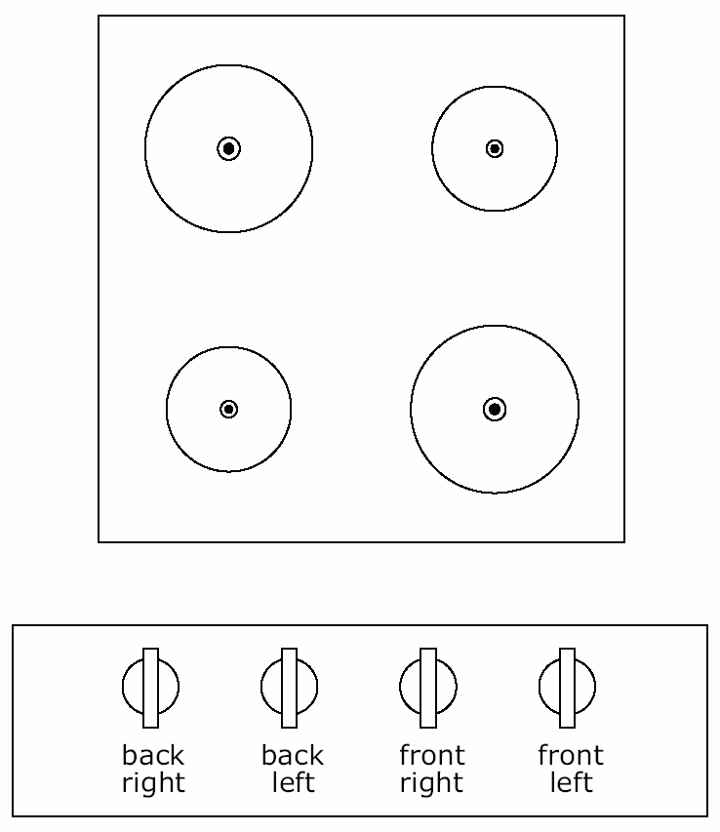
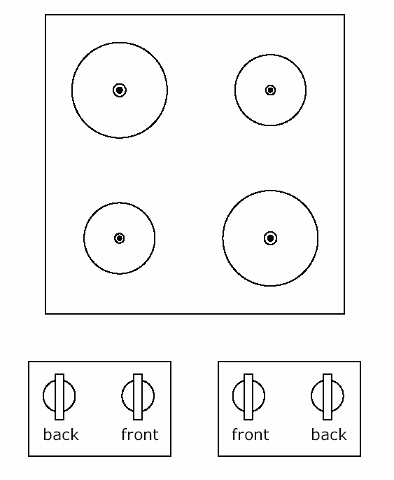
From Week3: Mapping of Cooker Controls
How should one arrange the hot plate controls on a cooker?
Arbitrary mapping of controls to hot plates. There are 24 possible arrangements, requiring the use of labels and memory.
Paired cooker controls. Now there are only four possible arrangements, two on each side, but confusion can still occur.

Slide 3
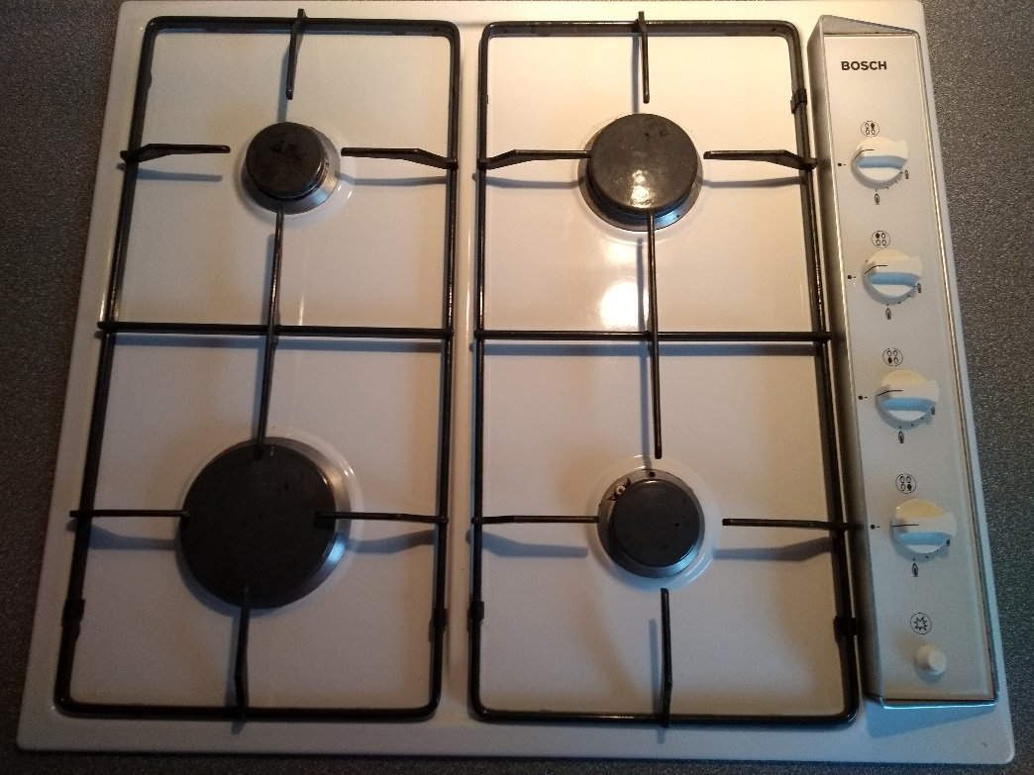
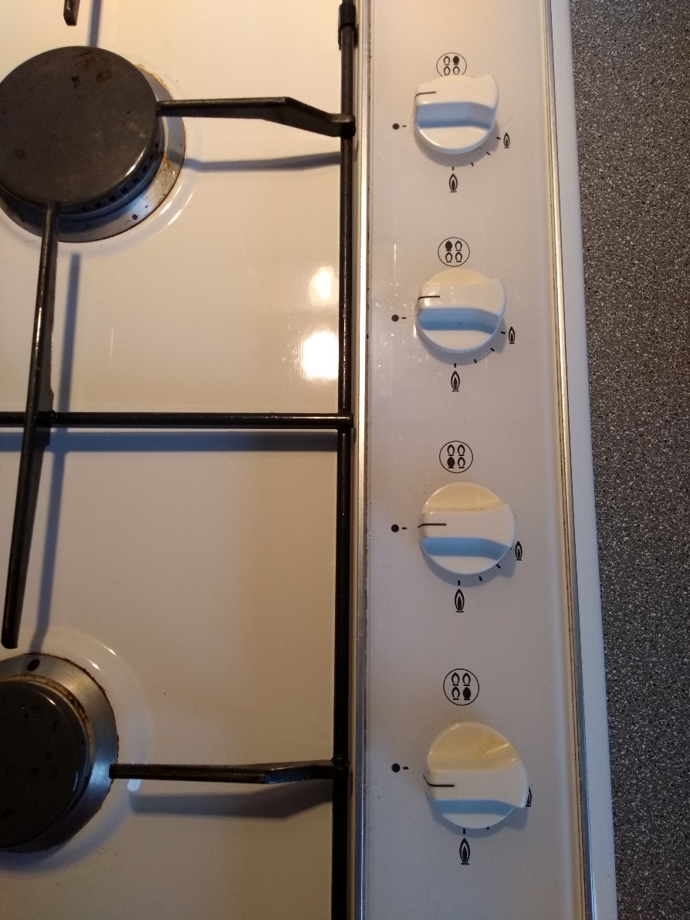
Huma’s Cooker Hob: better mapping of controls

Slide 4
Prototyping
Please read Lim et al. (2008) paper:
Lim, Y-K., Stolterman, E. & Tenenberg, J. (2008) The Anatomy of Prototypes: Prototypes as Filters, Prototypes as Manifestations of Design Ideas. ACM Transactions on Computer-Human Interaction (TOCHI) Vol 15(2)
This paper has been uploaded
In Moodle: Lecture section: Pre-Week4 Reading
To Learnium: main 106CR community

Slide 5
Prototyping and Structuring Information for interactive systems
Rapid prototyping & Information architecture
Storyboards and visual design
Task analysis for Navigation
Structures for Navigation

Slide 6
prototypes
simulate some features of the intended interface there are different types of prototypes:
• throw-away
uses a rough prototype to answer a design question
• incremental
uses the first prototype as the basis for the second

Slide 7
Throwaway prototype

Slide 8
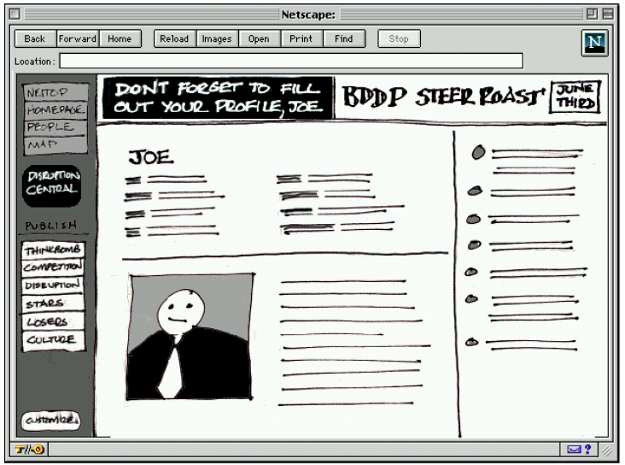
Storyboards (for visual design)
need not be computer-based
can be drawn on paper
Gives an impression of the ‘look’ of the interface

Slide 9
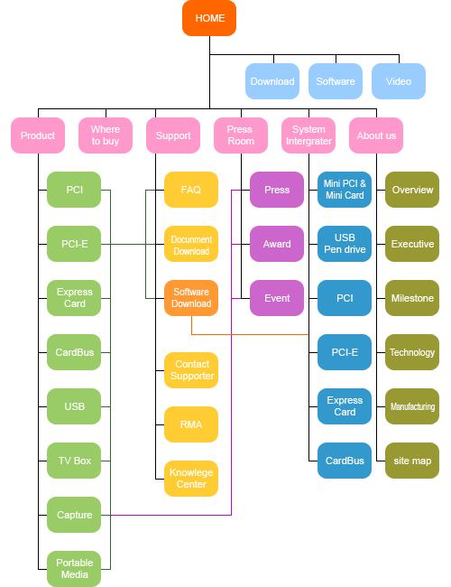
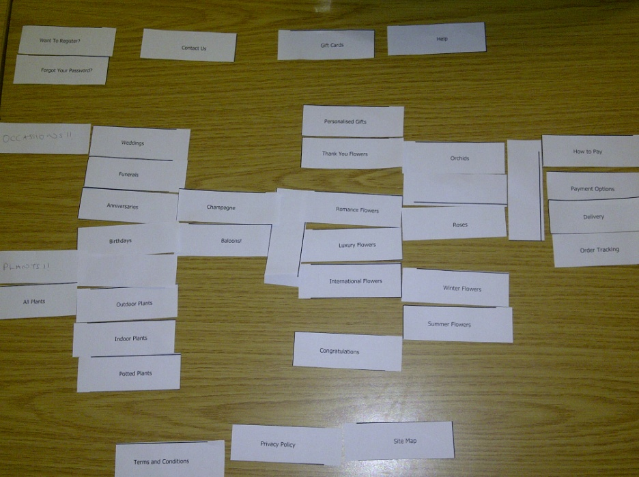
Flowcharts
Provide a map of the information architecture

Slide 10
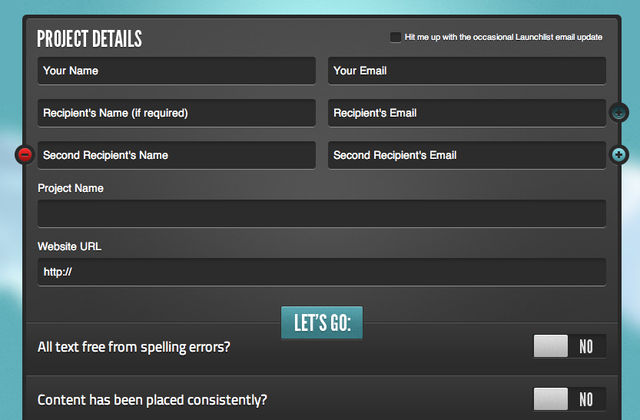
Limited functionality simulations (for interactions)
Can be used to user test properties of the interface. E.g. Forms can be tested to make sure they are usable.

Slide 11
A problem with prototypes …
Warning:
design inertia: early bad decisions stay bad
The time investment in a prototype produces a desire to ‘stay with it’ even if it exhibits problems.
You must be ready to observe and record user’s difficulties with the prototype and change the design accordingly – otherwise you are not prototyping you are building the final product!

Slide 12
What is Task Analysis?
A methods to analyse human actions:
what people do
what things they work with
what they must know

Slide 13
An Example
In order to clean the house
get the vacuum cleaner out
fix the appropriate attachments
clean the rooms
when the dust bag gets full, empty it
put the vacuum cleaner and tools away
A person must know about:
vacuum cleaners, their attachments, dust bags, cupboards, rooms etc.

Slide 14
Approaches to Task Analysis
Task decomposition
splitting task into (ordered) subtasks
general method
Observe the task
Collect unstructured lists of words and actions
Organize using notation or diagrams
Aims:
describe the actions people do
structure them within task / sub-task hierarchy
describe the order of subtasks

Slide 15
Hierarchical Task Analysis
Please read Shepherd (1998) journal article:
Shepherd, A. (1998) HTA as a framework for task analysis. Ergonomics, VOL. 41 (11), pages 1537-1552
You will find this paper uploaded to
In Moodle: Pre-lecture 4 Reading Shepherd-HTA
In Learnium: main 106CR community page
Please also see slides here: https://www8.cs.umu.se/kurser/5DV048/VT10/utdelat/F5-HTA.pdf

Slide 16
HTA description consists of 2 parts:
1) Hierarchy description ...
0. in order to clean the house
1. get the vacuum cleaner out
2. get the appropriate attachment
3. clean the rooms
3.1. clean the hall
3.2. clean the living rooms
3.3. clean the bedrooms
4. empty the dust bag
5. put vacuum cleaner and attachments away
2) ... and plans
Plan 0: do 1 - 2 - 3 - 5 in that order. when the dust bag gets full do 4
Plan 3: do any of 3.1, 3.2 or 3.3 in any order depending on which rooms need cleaning
Note: only the plans denote order

Slide 17
Types of plan
fixed sequence - do 1 then 2 then 3
optional tasks - if hall needs cleaning but other rooms do not, then do 3.1
wait for events - when dust bag is full do 4
cycles - do 3 while there are still dirty rooms
time-sharing - do 0; at the same time …(listen to music)
discretionary - do any of 3.1, 3.2 or 3.3 in any order
mixtures - most plans involve several of the above

Slide 18
Hierarchical Task Analysis
Problem: Stopping rules
How do we know when to stop?
Is “empty the dust bag” simple enough?
we need to expand only the relevant tasks
Motor actions: lowest sensible level

Slide 19
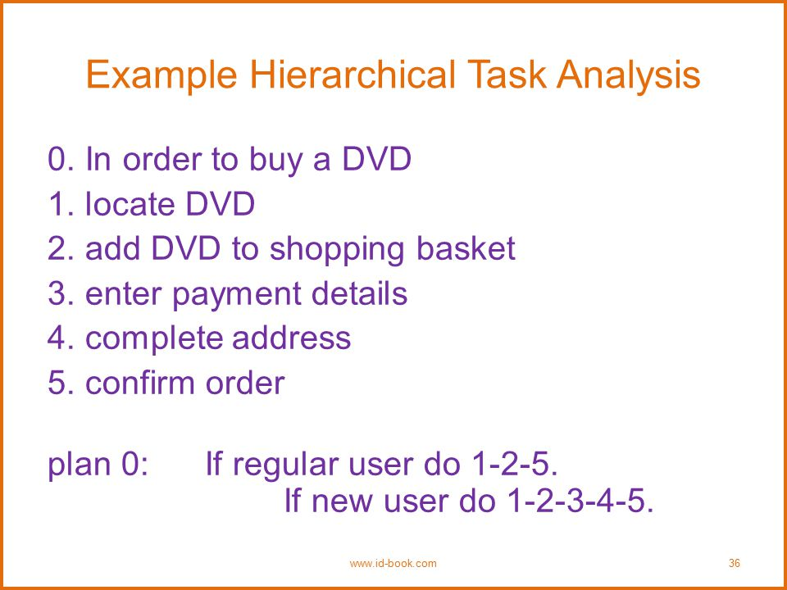
Hierarchical Task Analysis: Buying a DVD-1
From: http://slideplayer.com/slide/5261158/

Slide 20
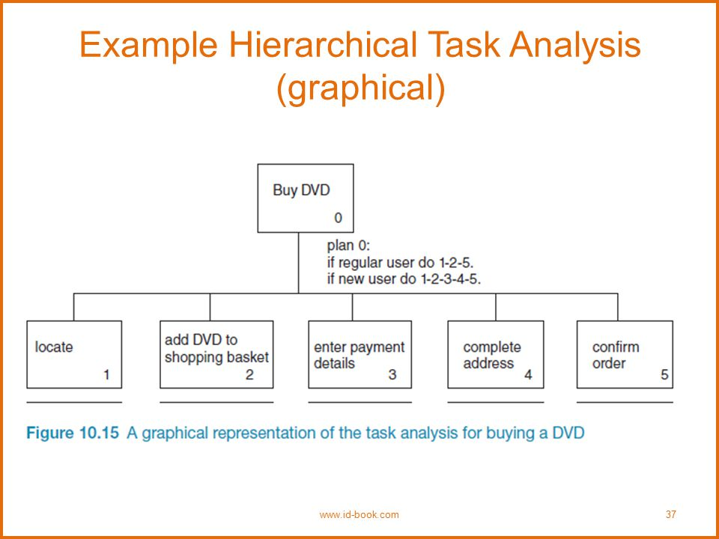
Hierarchical Task Analysis: Buying a DVD-2
From: http://slideplayer.com/slide/5261158/

Slide 21
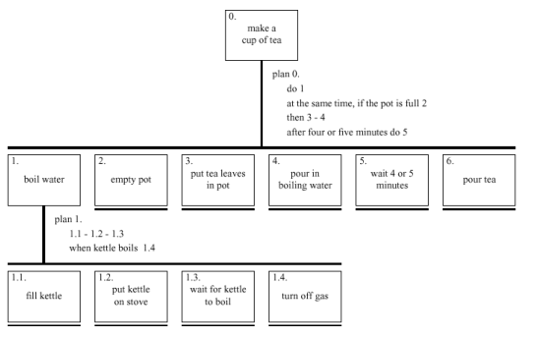
HTA for making a cup of tea
HTA image from the web

Slide 22
What can we use task analysis for?
Detailed interface design!
object/action lists suggest interface objects
task frequency guides default choices (for text boxes / drop down lists)
existing task sequences guide the order of the dialogue design

Slide 23
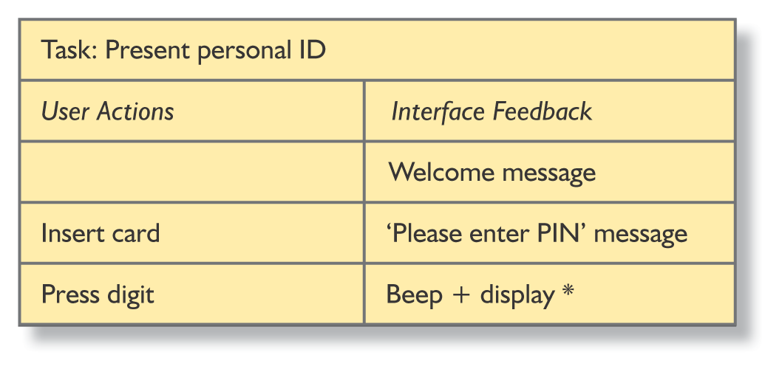
Existing task sequences guide dialogue design
Using our tasks and plans we can begin to build user / system dialogues…

Slide 24
From tasks to screen interactions
A key task in developing interactive systems is taking our analysis of real tasks and mapping them on to an interaction sequence in the interface.
We need to know about actions (commands), objects to be controlled, information to be input - all of which can be captured in the task analysis

Slide 25
Example: buying a book in town
You enter a book shop
You use the categories / labels on the shelves to select a type of book, for example, “science fiction”
The books are presented alphabetically – you could choose the author: “William Gibson” or “Neal Stephenson”
Select a book “Neuromancer” or “Cryptonomicon”
Browse for more books or you decide to leave and pay.
Visit the till, present the book and your mobile ‘phone or your bank card
The book is scanned.
Payment type is validated.
The book is wrapped and given to you.
You leave the shop.

Slide 26
Example: Buying a book online
Enter the URL of the online retailer:
Amazon; Waterstones; Cambridge University Press
Follow a link to browse by genre – selecting “science fiction”
OR use the search facility to find books by “William Gibson”
Select the book “Neuromancer”
Given the choice: “add to shopping cart and continue browsing” or “check out now” – you choose to check out.
You are presented with a form to enter your email address, delivery address and payment type. You do this and click “buy”
The site shows you a “confirm” page – with all the details you entered – it allows you to correct any mistakes in your data. Click “confirm”.
An email is sent to confirming all the details given, promising delivery within [X number] of hours/days.

Slide 27
Example: Buying a book online
In that example the interaction design for the online book shop maps closely onto an experience of buying books in a physical book shop – it matches the ‘mental model’ of the task.
There would be a problem if the online shop asked for payment before allowing the selection of a book (that would not happen in a ‘real’ shop)
There would also be a problem if you were asked to give unnecessary information about yourself when paying (e.g. income, where you heard about the shop, persuading you to sign up to their mailing list) – does this happen in a ‘real’ shop?

Slide 28
So now we know that:
Task analysis can be used to guide our decisions about the ‘flow’ or order of interaction in interface design – to bring it close to users’ mental models of the task – and to eliminate unnecessary elements from the interaction.
But we also need to know about:
The controls and input elements (widgets) that we can use to capture information from users, or to trigger system commands.
and
How to design the visual layout of input forms for maximum clarity and intelligibility.

Slide 29
Navigation structures
Most collections of information tend to have obvious internal structures of their own:
Historical sequence
Real world task order
Theme or topic
Size or scale
Geographic location

Slide 30
ORGANIZING INFORMATION AND CREATING FLOWCHARTS
Whilst a storyboard creates the initial picture of a Web design concept, a flowchart maps its structure and the intended user interaction.
The flowchart links together all the objects created in the interface and organises the different information presented.
Organizing information means more than just sorting it into categories – it also requires that a usable path is provided between categories

Slide 31
Navigation structures
When interface “pages” are linked together they form patterns which can be displayed visually on flowcharts – 3 general types:
Linear – one page follows the next
Hierarchical – involves navigation through a series of levels
Web-type – items are linked in a circular or looping fashion.
It is important to note that in reality these patterns rarely exist and a given web site will more likely use a combination of structural patterns

Slide 32

Linear Structure
The designer has absolute control of the sequence in which information is presented to the user.
User has little control.
Can be a useful structure if information HAS to be presented in a particular order e.g. the steps you need to go through to register on a web site (other forms: Wizards / installation applications).
Can be useful if users are not experts

Slide 33
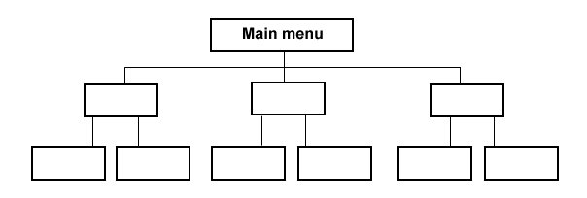
Hierarchical structure
While linear patterns suggest movement forward in a sequence, hierarchical patterns imply a ranking of different levels of ideas, a movement from the general to the specific, from set to subset.
Hierarchical structures are used in many web sites where the user's specific goal is to seek a piece of specific information (also describes how data is presented in many operating systems).
User has more choice over where to go and the designer has less control of the order of presentation

Slide 34
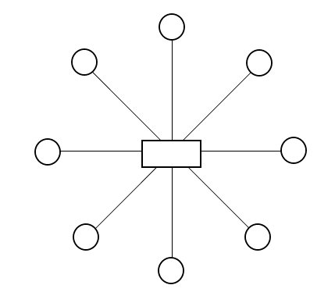
Open-ended Web Structure
This type of structure is extremely common
To stop users getting lost require a home page that is always 1 click away but can be complex to navigate.

Slide 35
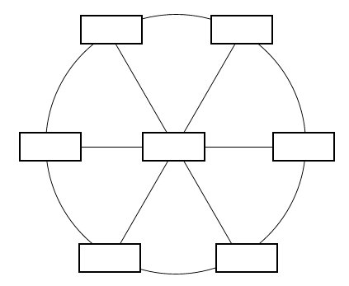
Closed Web Structure
All pages connect to all others
Freedom within limits
In a very complex web users can become lost

Slide 36
Choosing a navigation structure
There are two important factors:
1: The nature of the information
A linear structure is good for a set of instructions
A - Stand at the kerb (next)
B - Look left and right (next)
C - If its all clear then cross (next)
D - Keep looking and listening (next)
E - Well done (end / return to start)

Slide 37
Choosing a navigation structure
Hierarchical structure
e.g. Searching for items on an e-commerce site
Books
CD’s
Games
Non-fiction
Fiction
Pop
Jazz
Playstation
PC

Slide 38
Choosing a navigation structure
Important factors:
The needs of our important users
Novice users often need help to understand interface navigation - a linear structure that ‘keeps them on the path’ is very useful
Expert users need access to information quickly. A linear structure would slow them down - A hierarchical or ‘Closed’ web structure would suit expert users better

Slide 39
Navigation shortcuts (Accelerators) As well as providing an appropriate navigation structure Ben Schneiderman suggest providing ‘short-cuts’ to speed up navigation. Search engines Shortcut icons Table of contents Index Site-map ‘History’ list Pull-down menu Agents and guides - You will understand this when completing Week4 lab activity See Schnederman’s “8 golden rules of interface design”: https://faculty.washington.edu/jtenenbg/courses/360/f04/sessions/schneidermanGoldenRules.html

Slide 40
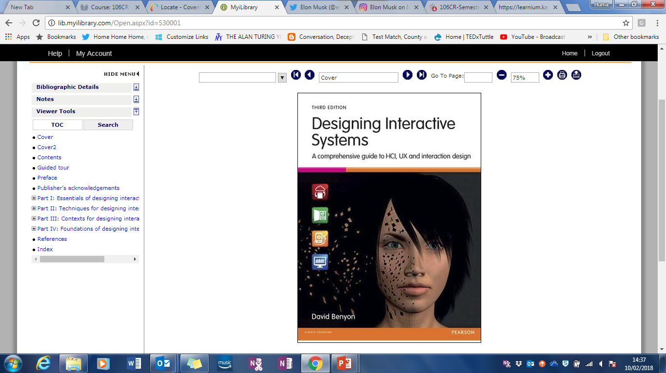
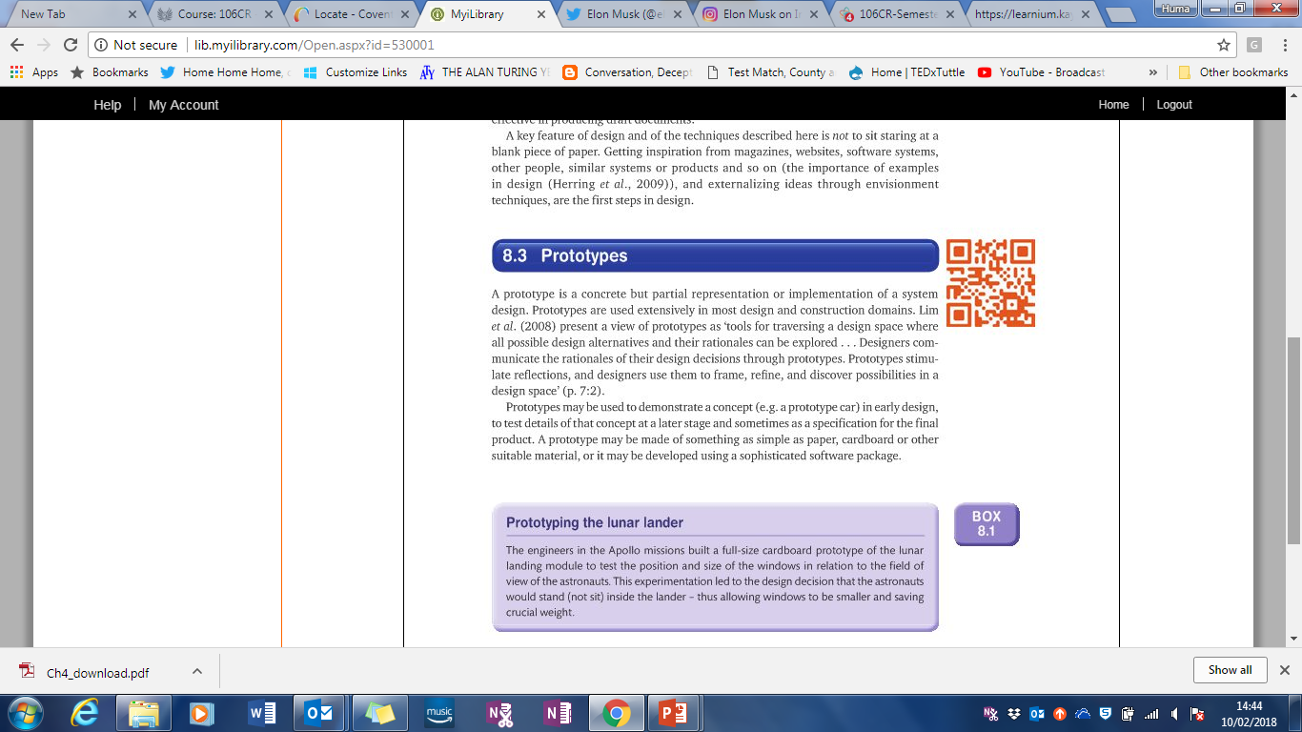
Benyon 3rd edition
Online version of David Benyon book, 3rd edition available via LOCATE : read chapters 7-8
Page 175: Prototypes

